Slide 1
Android GNSS Raw Measurements and Galileo High Accuracy Service
Martin Sunkevic, European GNSS Agency
29 November 2018
RNN`s New GNSS Signals seminar – opportunities for new PNT applications and improved robustness

Slide 2
Presentation Outline
GSA and Galileo HAS
Android Raw Measurements
Main benefits/uses of Raw measurements
GSA Raw Measurements Task Force

Slide 3
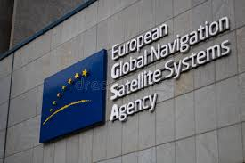

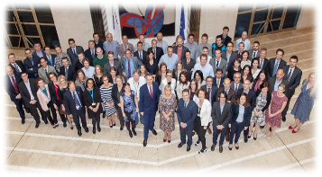

The European GNSS Agency (GSA) is responsible for market development and operations of Galileo and EGNOS
Staff: around 160
Nationalities: 22
Headquarters: Prague, Czech Republic
Other Locations:
in charge of managing operations and service provision of Galileo (2017) and EGNOS (2014)
delivering safe and secure European satellite system
ensuring that European companies are using Galileo and EGNOS
making sure that European citizens are benefitting from EGNOS and Galileo
  France
  The Netherlands
  Spain
  Belgium

Slide 4



Galileo deployment is progressing
4 Galileo satellites successfully launched on a customized Ariane 5 on 25/07, 2018
2005
2006
2007
2008
2009
2010
2011
2012
2013
2014
2015
From
Baïkonour
From
Kourou
"GIOVE-A"
"GIOVE-B"
1-2
3-4
5-6
7-8
2015
2016
2017
2018
2019
2020/21
27-28
29-30
31-32
26 satellites already launched,
more satellites already bought and under preparation
9-10
11-12
13-14
15-16
17-18
19-20
21-22
23-24
25-26
Galileo Initial Services
Soyuz
Ariane 5
Ariane 62
Notes:
SAT 16-18 Usable, 15 and 19-22 Under Commisioning
2nd of August – 3 new satellites inserted in the nominal constellation

Slide 5
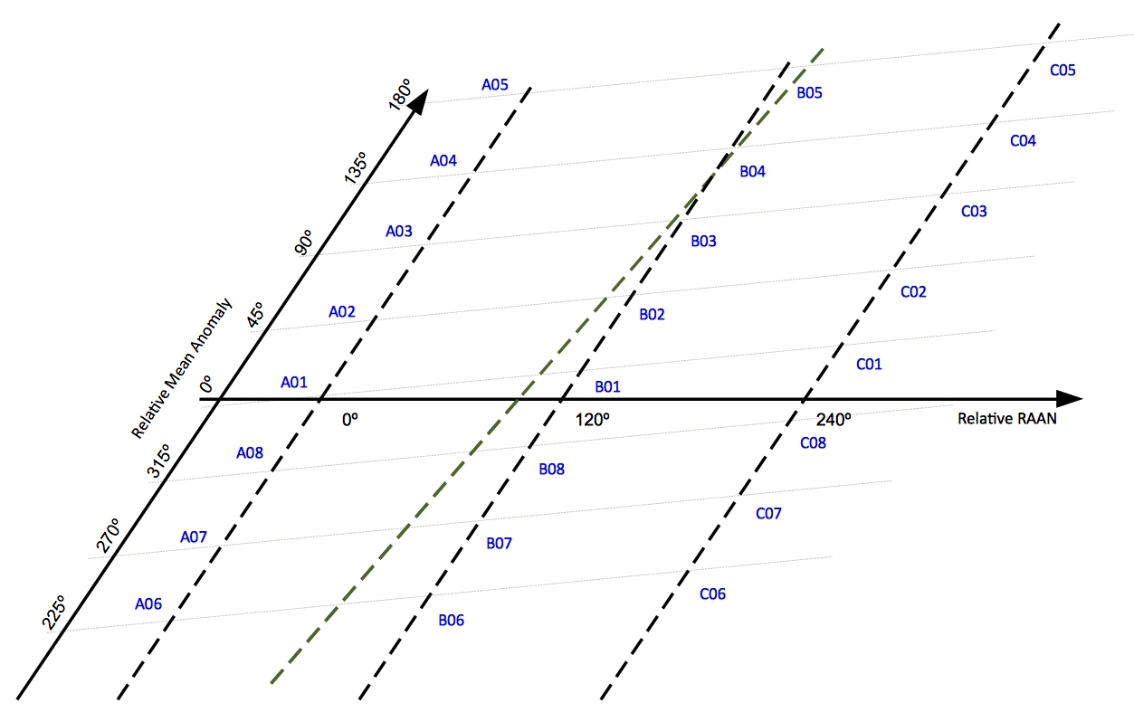
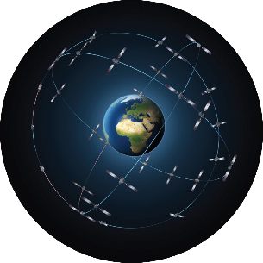


Galileo Constellation Status
Navigation Payload
(18 Operational)
26 satellites in orbit
4 under commissioning
2 in testing
1 spare
1 unavailable
Search and Rescue Payload
(19 Operational)
2 out of 26 satellites with no SAR Transponder (by design)
4 under commissioning
1 spare
Plane A Plane B Plane C
0 unoccupied reference slots

Slide 6
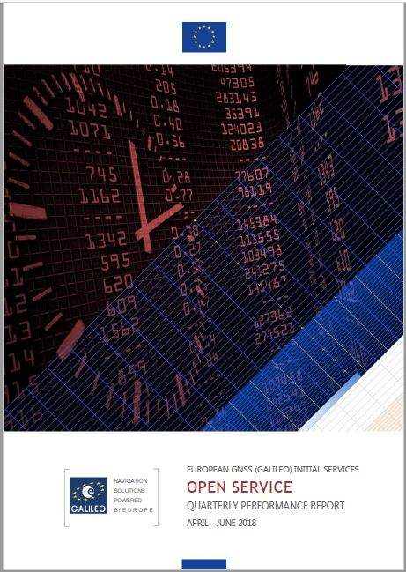

Quarterly Performance Reports
Following the declaration of Initial Services in December 2016, the Galileo Initial Open Service (OS) and the Galileo Search and Rescue (SAR) Service Public Performance Reports are published quarterly, to provide the public with information about the Galileo OS and the Galileo SAR Service measured performance statistics
OS Performance Report - Q2 2018
SAR Service Performance Report - Q2 2018

Slide 7

Galileo is the European GNSS offering a wide range of services
Open Service (OS)
OS-Navigation Message Authentication (OS-NMA)
Public Regulated Service (PRS)
Search and Rescue Service (SAR)
High Accuracy Service (HAS)
Signal Authentication Service (SAS)
  Freely accessible service for
  positioning, timing and navigation message authentication (OS-NMA)
  Encrypted service designed for greater robustness and higher availability
  Assists locating people in distress and confirms that help is on the way
  Freely accessible high accuracy positioning service
  Authentication service based on the E6 signal code encryption, allowing for increased robustness of professional applications

Slide 8
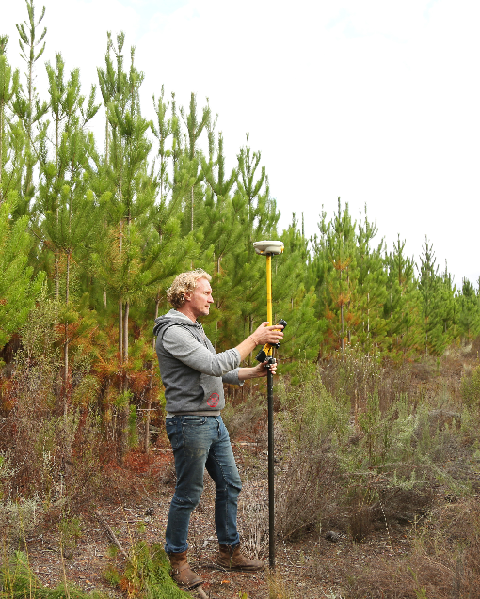
Commercial Service goes for FREE
As per EU GNSS regulation, Galileo foresees a Commercial Service (CS) offered for a fee for professional apps
In early 2017, the EU adopted a Decision (Implementing Decision 2017/224) defining the fee-based CS as High Accuracy Service (CS-HA) and Authentication. CS-HA was foreseen to be based on commercial, proprietary format, not under Galileo’s responsibility
However, new circumstances taken into account: high accuracy broadening towards the mass market and being offered for free already by satnav providers and other public entities.
Re-assessment process has culminated in an amendment to the Decision (Implementing Decision 2018/321), to redefine the High Accuracy service and provide it for free.

Slide 9
Overview of signals
Open service / High Accuracy Service / E6 ranging
E6 ranging
OS-NMA
Signal
E1b
E1c
Spreading code
Unencrypted
Unencrypted
Data
E5a
E5b
E6b
E6c
Unencrypted
Unencrypted
Unencrypted
Encrypted
Service
Yes I/Nav (+NMA)
No (Pilot)
Yes I/Nav
Yes F/Nav
Yes C/Nav
No (Pilot)
OS single frequency
OS dual frequency
Free multi-frequency
HAS
SAS
Signal Authentication
Notes:
Add technology report
Galileo services are defined on specific frequencies and their signal components.
Some of the signals carry data and others do not – pilot signals. The pilot signals improve data demodulation.

Slide 10
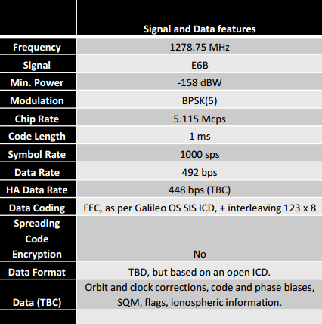
HAS will be offered for free and using standard format
High accuracy (PPP) corrections provided in the Galileo E6-B signal component (= no need for additional communication channel):
  Satellite orbits
  Satellite clock corrections
  Code biases for multi-frequency
  Signal/correction quality information
  Phase biases (TBC)
  Ionosphere in EU (to be confirmed)
Corrections will be disseminated for (E1, E5a, E5b, E6b, E5(TBC)) and GPS (L1, L2, others TBC), and in the future potentially for other GNSS
Global coverage when fully operational, partial coverage before (EU will be always included)
HAS data transmitted for free, based on (used as a starting point) open standard format RTCM CSSR (currently under definition)
‘’target horizontal user error around two decimetres’’, depending not only on user receiver, algorithm and environment (currently under definition)
HAS distribution via terrestrial network (under consideration)
Notes:
AD1: Ionosphere in EU (to be confirmed): It will be the so-called PPP-RTK (which is not RTK like, the only commonality is the need for denser network of base stations) , then convergence few seconds
AD2: HAS data transmitted openly, for free, (based on, used as a starting point) open standard format RTCM CSSR (format under definition): It is going to be similar as QZSS’s CLAS one

Slide 11
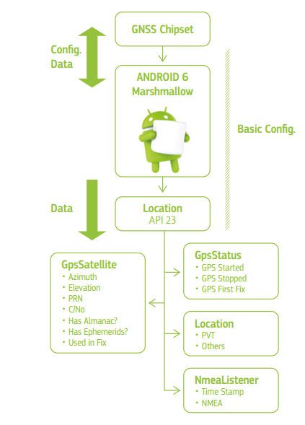
Android GNSS Raw Measurements (1)
Google made available GNSS Android Raw Measurements in August 2016 with the release of Android 7 (Nougat)
Before that, developers had access (with API 23) to the following Android classes
  GPS Satellite, containing such basic satellite information as azimuth, elevation, PRN and C/No. It also ﬂags if the satellite is used in the PVT solution and the availability of almanac and ephemerides.
  GPS Status provides information about the status and solution of the GNSS chipset.
  Location, indicating if a positional and time solution is provided.
  NMEA Listener, providing basic NMEA sentences.

Slide 12
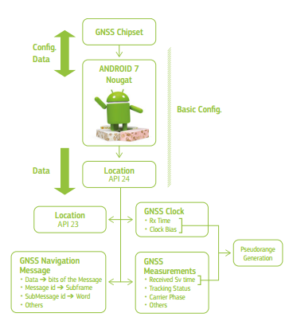
Android GNSS Raw Measurements (2)
From API 24 (Android 7), developers have access to (API 23 and) the following GNSS raw and computed information via Android classes:
GNSS Clock, that contains:
- Receiver time;
- Clock bias.
GNSS Navigation Message that contains:
- Navigation Message bits (all the constellations);
- Navigation message status.
GNSS Measurement that contains:
- Received Satellite Time;
- Code;
- Carrier phase.

Slide 13
Android GNSS Raw Measurements (3)
Processing chain in generic GNSS receiver
RF signal is down converted to baseband or IF frequency
The signal is digitalized by the ADC
The baseband module acquires and tracks the code and the carrier
Pseudoranges and PVT is computed
Raw measurements comes before pseudorange generation !
Raw measurements
Baseband Processing:
Code&Phase
Pseudorange Generation
& Message Decoding
PVT Computation
PVT
SV Info
RF Front-End
ADC
GNSS
Chipset
External Information (Assisted Data)
External Sensors

Slide 14
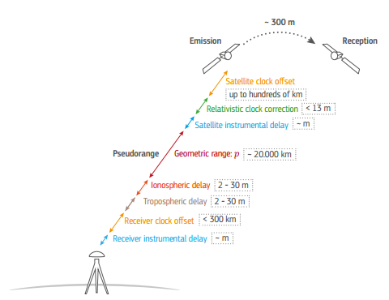
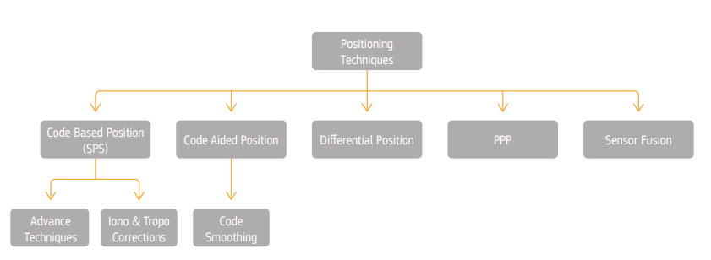
Android GNSS Raw Measurements (4)
Why is it so interesting?
you can use android devices to calculate pseudoranges, have access to carrier phase, and calculate PVT on your own, while using additional data from other sensors and sources
Sources of GNSS pseudorange measurement errors

Slide 15
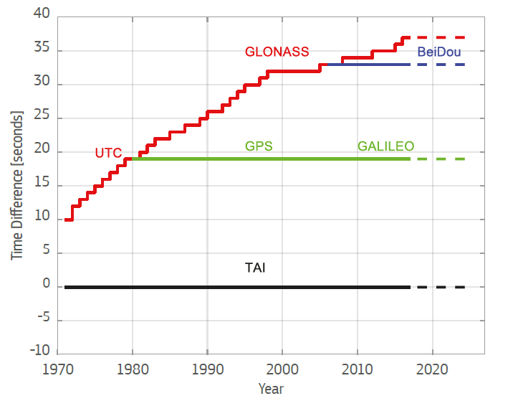

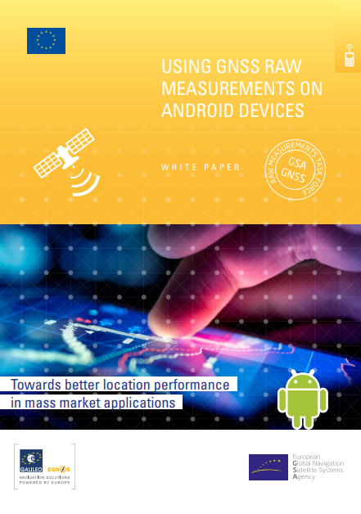
Challenges when generating the pseudoranges
challenges when generating the pseudoranges
  In Multi-constellation just one reference time must be used: GPS time usually chosen
  The transmission time (T_{Tx}) can be ambiguous depending on your tracking status
  Resolving the bias between hardware receiver time (internal timescale provided by the Rx) and GNSS time
for more see
GPS |  | GALILEO |  | GLONASS |  | BeiDou
Sync | Status Time | Sync | Status Time | Sync | Status Time | Sync | Status Time
C/A code | 1 ms | E1BC code | 4 ms | C/A code | 1 ms | C/A code | 1 ms
Bit | 20 ms | E1C 2nd code | 100 ms | Bit | 20 ms | Bit | 20 ms
Subframe sync | 6 s | E1B page | 2 s | String | 2 s | Subframe sync | 6 s
TOW | 1 week | TOW | 1 week | Time of Day | 1 day | TOW | 1 week
Values bigger than the propagation time can be used for unambiguous pseudorange determination
Notes:
TimeNanos = Hardware Receiver Time

Slide 16

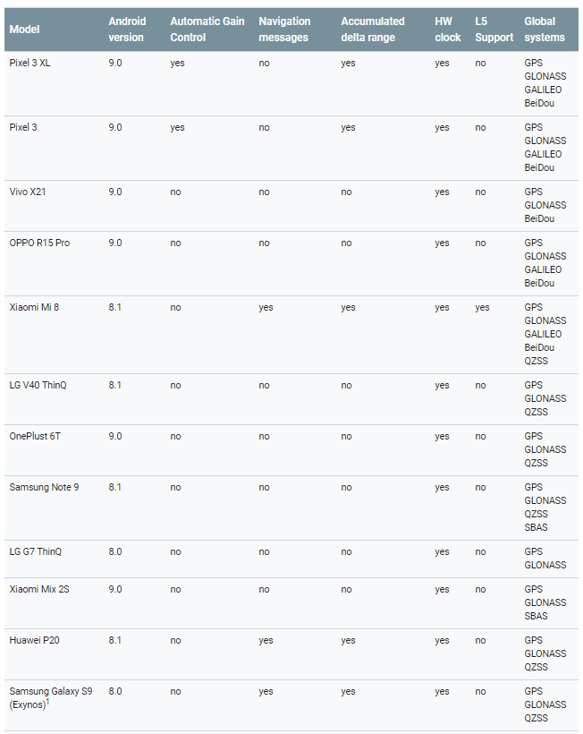
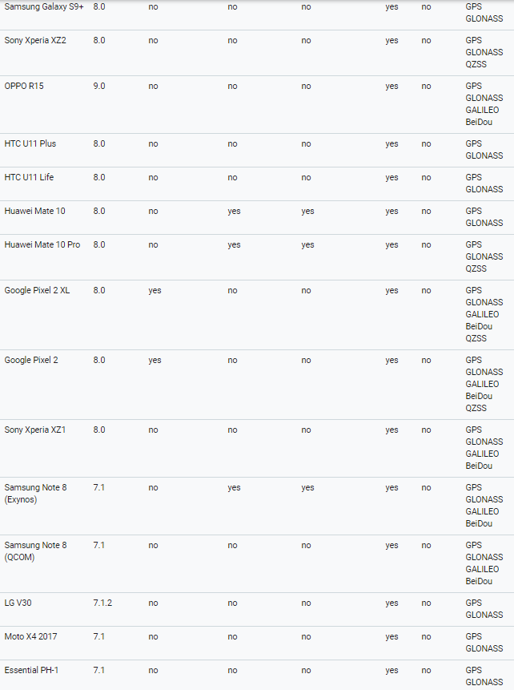
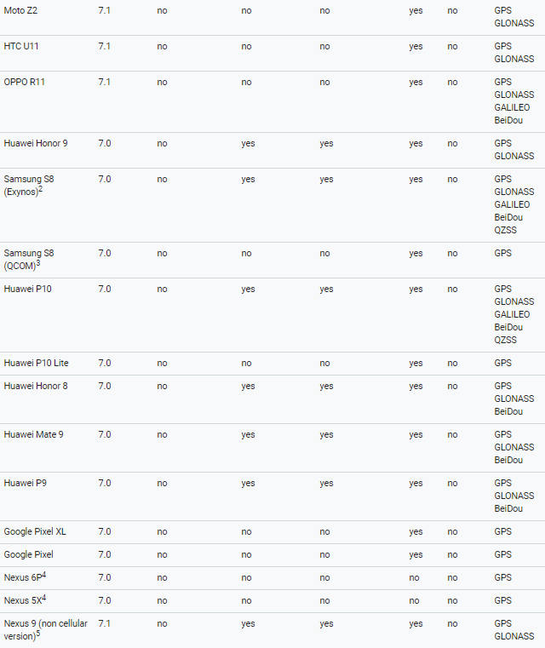

Android devices that support raw measurements
Go to https://developer.android.com/guide/topics/sensors/gnss

Slide 17
What are the benefits/ main uses of GNSS raw measurements?
Scientific use and R&D
Increased accuracy
Four main areas of use are enabled by GNSS raw measurements
• As the observations are provided in a much more coarse form they can be used for testing hardware and software solutions and for new post processing algorithms e.g. for modelling ionosphere or troposphere.
• Subject to hardware limitations, access to raw measurements means a developer can employ advanced positioning techniques (RTK, PPP) and create a solution currently only available in professional receivers.
• It results in a technological push to develop new applications.
1
Testing, performance monitoring and education
Integrity/Robustness
• Access to raw measurements will offer new ways to detect RF interferences and to locate the interference source by combining the measurements from multiple devices (crowdsourcing), or verify the source (OS-NMA).
• SBAS corrections can be incorporated without the need for additional equipment.
• Raw measurements can be used for monitoring performance (data, accuracy, Rx clock), testing and to compare solution from single constellations, eliminate specific satellites or test for worst scenario performance.
• Education use for understanding GNSS, Signal processing or orbits in smartphone is not negligible too.
2
3

Slide 18
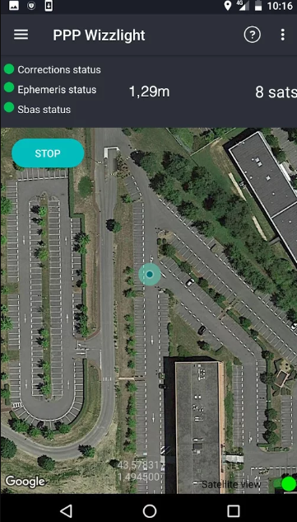
High accuracy apps
1
Example of app providing high accuracy: PPP WizzLite
based on raw GNSS measurements, the app uses high level algorithms developed by the French Space Agency (CNES PPP-Wizard)
Accuracies of 1-2 meters can be reached in kinematic mode and sub-meter in static mode
To do so, users need to pull external RTCM streams for orbits/clocks corrections and broadcasts, such as ones available from the International GNSS Service Real-Time Service (IGS RTS)

Slide 19


Integrity/robustness: Galileo OS Navigation Message Authentication
2
Clear differentiator w.r.t. other GNSS available to the civil community
Disseminated on the first Galileo frequency (E1B)
Contributes to mitigate GNSS vulnerabilities
No need to store secret keys in the Rx, just public key
Follows crypto standards and recommendations to be secure over the next decades
Fully backward compatible
“Navigation Message Authentication” is the ability of the system to guarantee to the users that they are utilising navigation data that has not been modified and comes from the Galileo satellites and not from any other source.
Can be used by apps in near future thanks to access to raw measurement navigation message
Ref. Galileo Navigation Message Authentication Specification for Signal-In-Space Testing – v1.0 (to be updated)
19

Slide 20
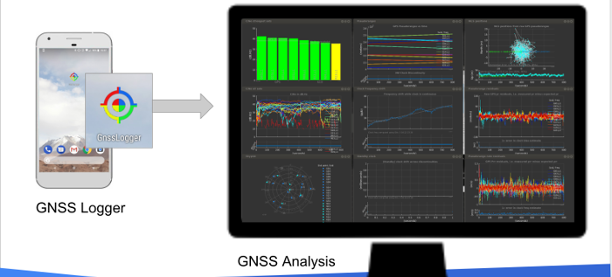
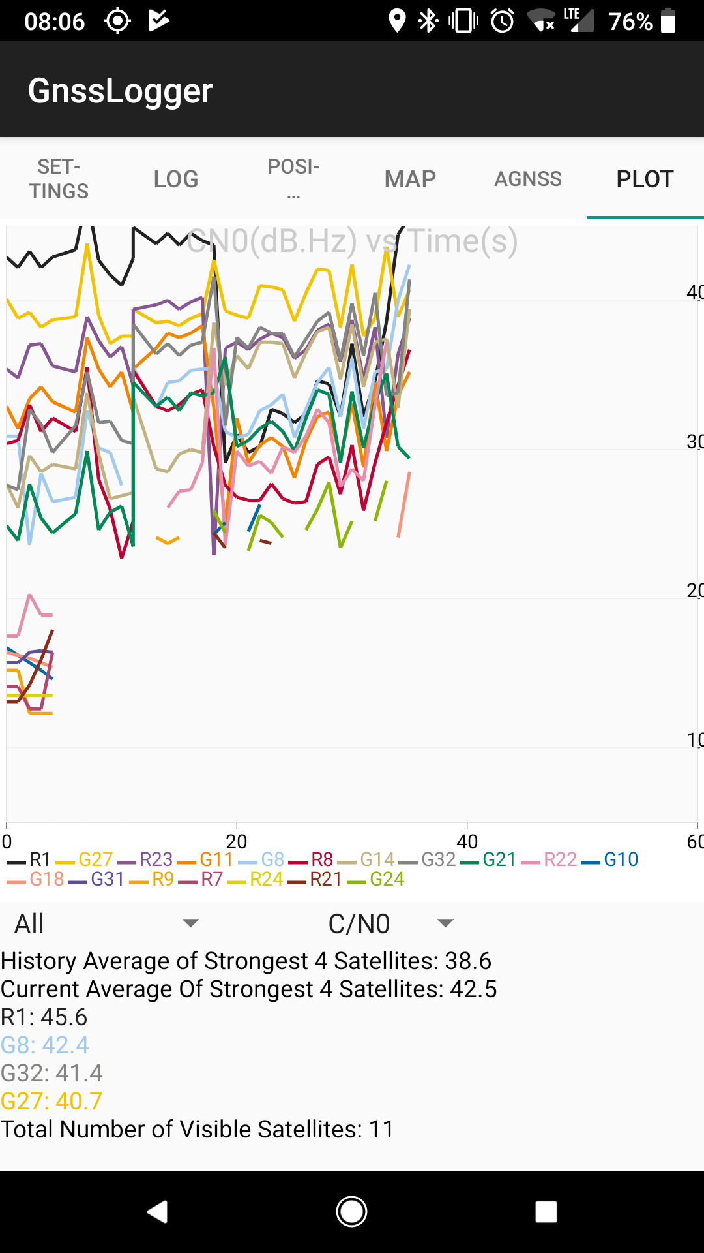
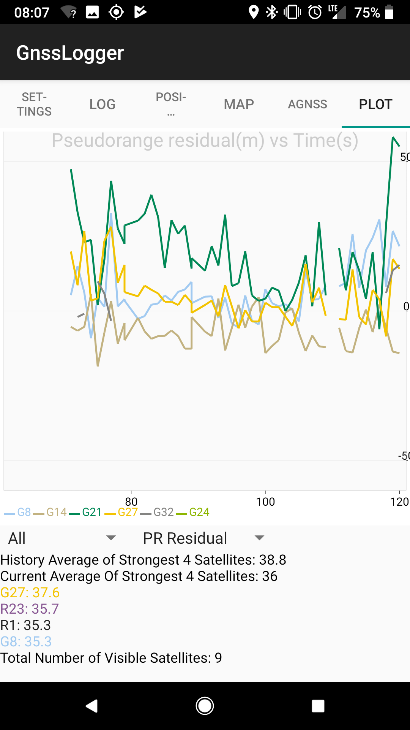
Education/Testing: Logging and monitoring apps (1)
3
GNSS Logger:
The GNSS Analysis reads the GPS/GNSS raw measurements collected by the GNSS Logger app and uses them to analyze the GNSS receiver behaviour
The GNSS Analysis app is built on MATLAB, but you don't need to have MATLAB to run it. The app is compiled into an executable that installs a copy of the MATLAB Runtime
New in 2018:
duty cycling control
Analysis on the phone

Slide 21

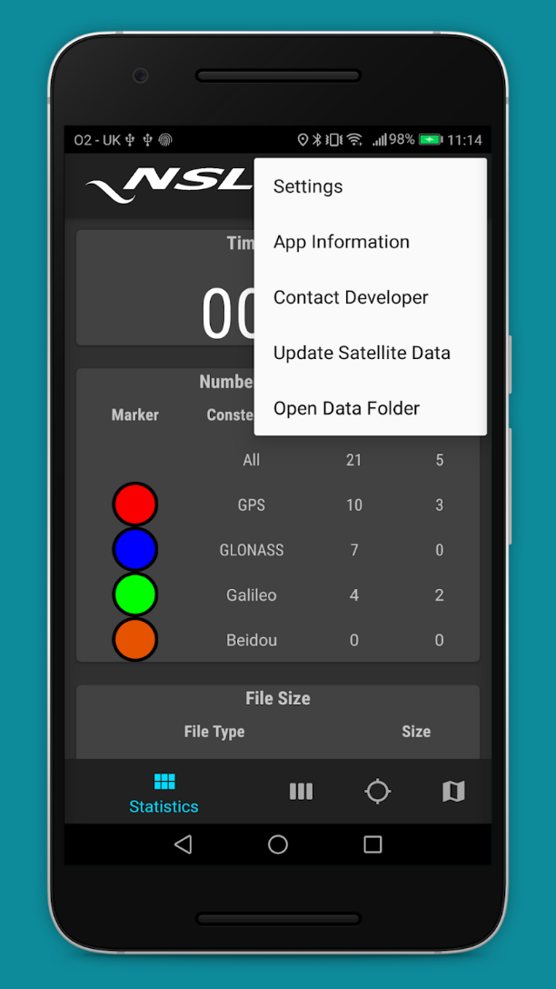
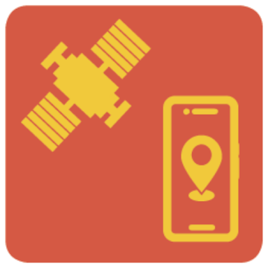
Education/Testing: Logging and monitoring apps (2)
3
Written by NSL as part of the H2020 FLAMINGO project
An ongoing development as the project progresses
Includes:
  RINEX Observation and Navigation Message File writer. Can choose constellations
  GNSS skyplot and satellite planner in 24-hour timescale
  Signal-to-noise (signal strength) graphic
  Satellites tracked and measured monitor
  File size monitor
RINEX ON

Slide 22
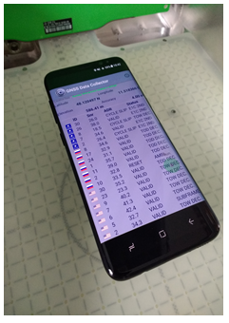
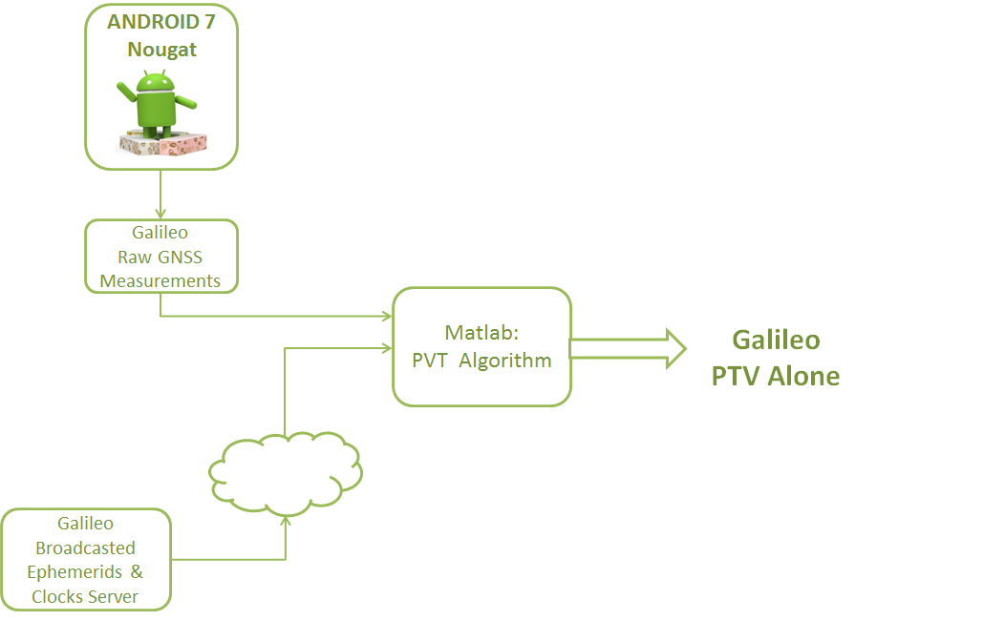

Galileo PVT
3
Education/Testing: Outputs of GSA smartphone testing campaign (1)
Testing campaign done under contract with Airbus D&S
Galileo Raw Measurements from Samsung S8
Broadcasted Ephemerids & Clocks from Server (IGS)
PVT algorithm implemented in Matlab, logging Airbus GNSS Logger

Slide 23
Galileo PVT
3
Education/Testing: Outputs of GSA smartphone testing campaign (2)
Galileo-only PVT – Open Sky, Static
  5 Galileo Satellites used for the PVT solution
  2.9 meters accuracy (50%)
  8.4 meters accuracy (95%)

Slide 24
Galileo PVT
3
Education/Testing: Outputs of GSA smartphone testing campaign (3)
GPS vs GPS + Galileo PVT - Open Sky, Static
  5 Galileo Satellites used for the PVT solution
    GPS alone 6.7 meters error
    Galileo increases the accuracy up to 4.5 meters

Slide 25
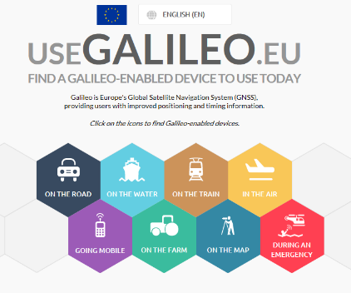














Galileo is used today on the majority of professional devices and increasingly many consumer platforms

Slide 26
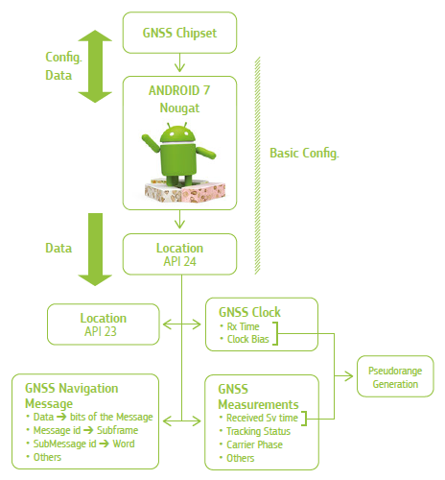
Galileo usage in PVT
3
Education/Testing: Outputs of GSA smartphone testing campaign (4)
Which satellites have been used in the PVT by phone?
Google Location class:
Satellites used for PVT
Ephemerids and almanac available
Analysis of Galileo usage by phone in PVT can be done

Slide 27
Galileo usage in PVT
3
Education/Testing: Outputs of GSA smartphone testing campaign (5)
PVT & Tracking: Percentage over the in-view healthy Galileo Satellites
Same scenario for both phones

Slide 28
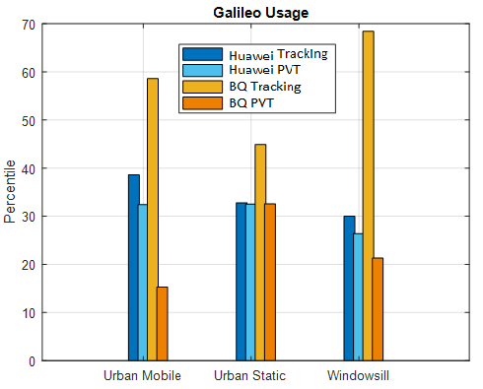
Galileo usage in PVT
3
Education/Testing: Outputs of GSA smartphone testing campaign (5)
PVT & Tracking: Percentage over the in-view healthy Galileo Satellites
Huawei P10:
Almost all the measurements are used in the PVT solution.
Less than 40% of the measurements are tracked
BQ:
More than 45% of the measurements are tracked in all the scenarios.
Up to 70% of the measurements are tracked in the windowsill scenario
The measurements used in PVT reduced
Comparison:
Huawei uses a bit more of the Galileo measurements for the PVT solution
BQ tracks almost 2 times more the Galileo satellites compared to Huawei

Slide 29
Galileo usage in PVT
3
Education/Testing: Outputs of GSA smartphone testing campaign (6)
Tracking per Constellation : Channel allocation per constellation
Same Scenario for both phones

Slide 30
Galileo usage in PVT
3
Education/Testing: Outputs of GSA smartphone testing campaign (7)
Tracking per Constellation : Channel allocation per constellation
Same Scenario for both phones
Huawei P10:
15% of the channels track Galileo satellites
BQ:
28% of the channels track Galileo satellites

Slide 31
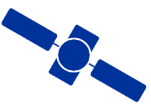
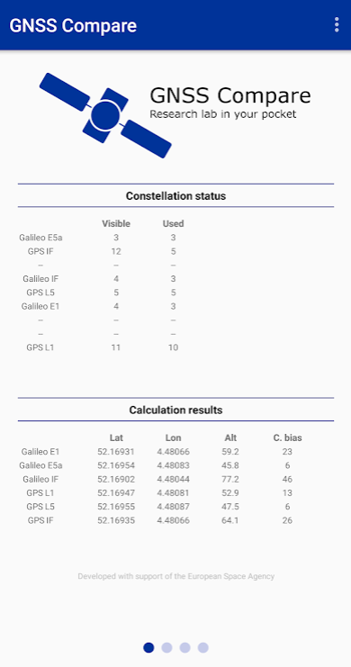
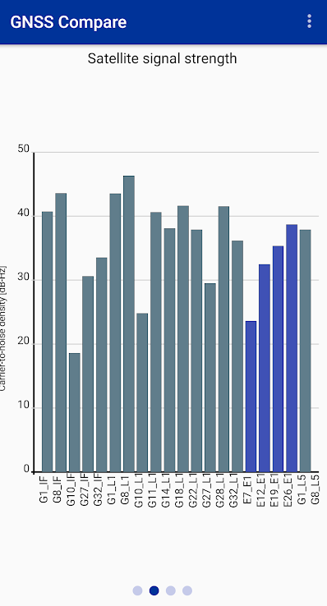
3
Education/Testing: GNSS Compare
Winner of ESA`s Smartphone App competition 2018: GNSS Compare
“The purpose of GNSS Compare is to make the life of developers and researchers easier. It’s an easy to use and easy to extend Android-based framework for calculating the Position, Velocity and Time (PVT) based on the raw GNSS measurements”
Open source code on github https://github.com/TheGalfins/GNSS_Compare
Online documentation: https://gnss-compare.readthedocs.io
Available PVT estimators: Weighted Least Squares, Extended Kalman Filter
- Data logging formats: Simple Logger (UTC timestamp, X, Y, Z), NMEA (UTC timestamp, lat, lon, alt, CN0), Raw GNSS measurements (Google’s GnssLogger format)
Supports dual-frequency

Slide 32
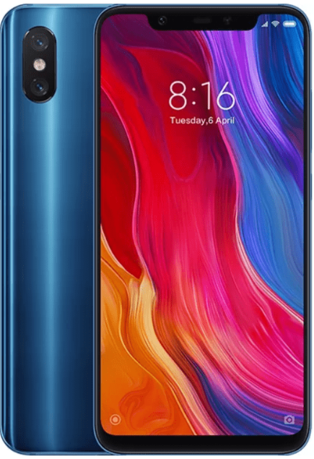

Dual-frequency phones
Xiaomi`s world’s first dual-frequency GNSS smartphone Mi8
Fitted with a Broadcom BCM47755 chip
launched on May 31 2018
the world’s first smartphone providing below meter accuracy for location-based services and vehicle navigation
Raw measurements can help to provide even higher accuracy
Use L1/E1 and L5/E5 frequencies
Huawei`s first dual frequency GNSS smartphone Mate 20 Pro
Fitted with the Broadcom BCM47755 chip too
launched on November 2018

Slide 33
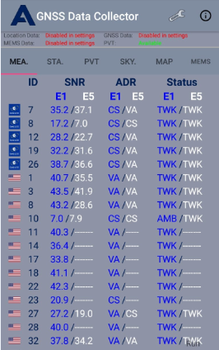
Some results of the dual-frequency smartphone

Slide 34
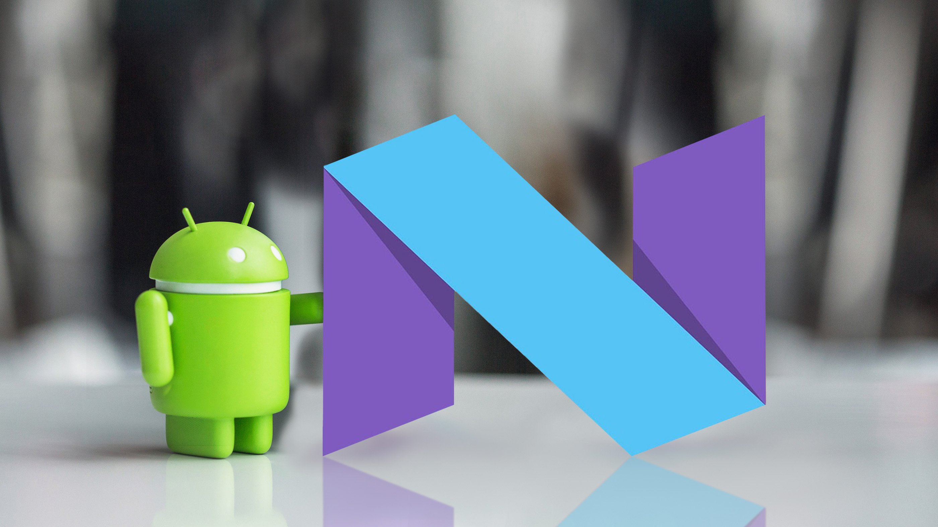
GSA Task Force: created shortly after Google`s announcement
The GSA GNSS Raw Measurements Task Force was established following the announcement of Google in 2016 to make the Android Raw Measurements available from Android 7.0
  Continuously open call for participation (write to market@gsa.europa.eu )
  No fee for membership
Objective(s):
-“to share knowledge and expertise on Android raw measurements and its wider use, including its potential for high accuracy positioning techniques”
- “valorise the Galileo differentiators”

Slide 35

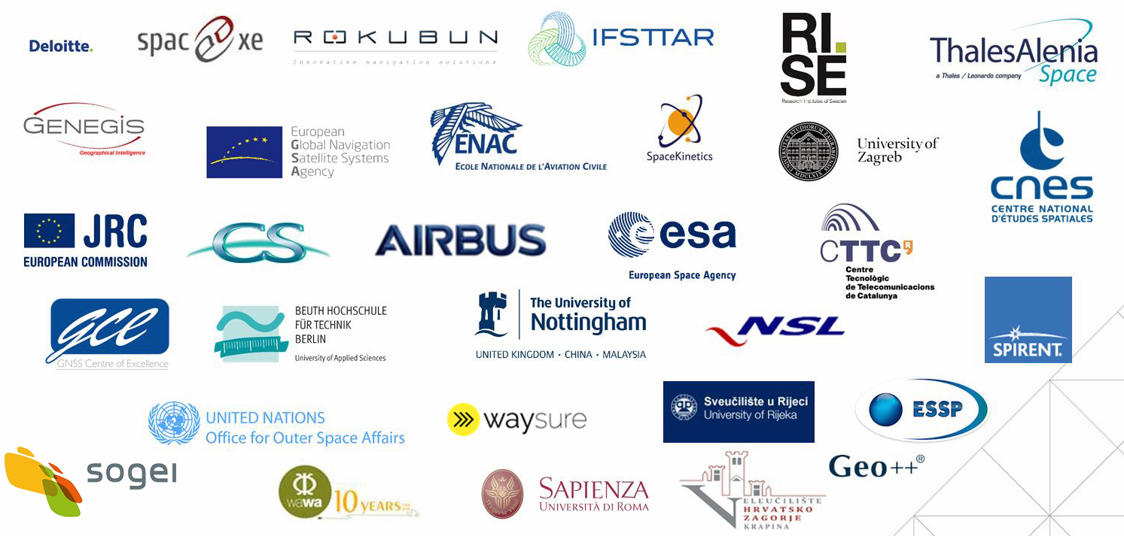
GSA Task Force: Short history
First workshop took place in July 2017 (over 30 participants)
  Meeting served as a brainstorming event for what later became the White Paper
Testing results of some members were presented during ION 2017 conference in Portland, USA
Second workshop in May 2018 in Prague
Task force has more than 100 members (these are “founding” ones)
The Task Force includes GNSS experts, scientists and GNSS market players

Slide 36
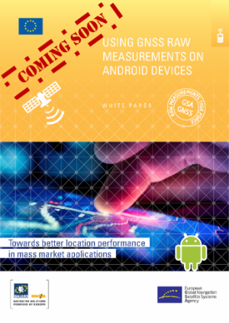
GSA Task Force: Galileo Raw measurements White Paper published in January 2018
Part I: overview of the theoretical basics needed to reconstruct GNSS raw measurements using Android, including a basic overview of GNSS, GNSS time references, pseudoranges, navigation messages and position estimation
Part II: information on how to access and use raw measurements, including generating pseudoranges and Doppler
Part III: a look at the most promising techniques and discussion on the benefits and limitations of each technique
Part IV: use cases that may benefit from the increased accuracy and integrity obtained with the use of GNSS raw measurements
Available for download
at GSA website

Slide 37
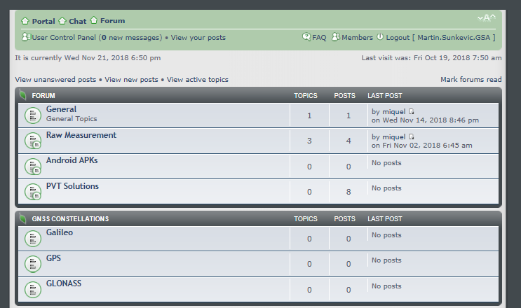
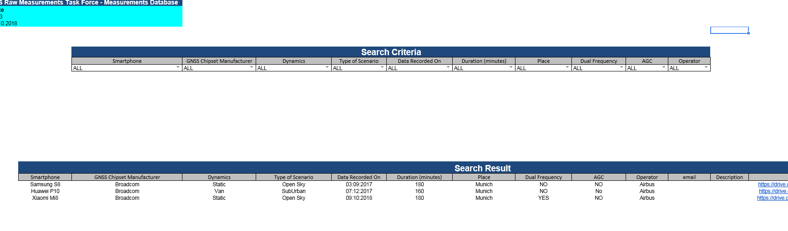
GSA Task Force: Discussion Forum and Measurements Database
Discussion Forum set up for the TF members
  http://rawmeasurementstaskforce.forums-free.com
Database of measurements at Google Docs
  https://docs.google.com/spreadsheets/d/1Li4aKf43eJipZGweWpEIRHaRgj4tSacZ9WNuPHObt88/copy

Slide 38
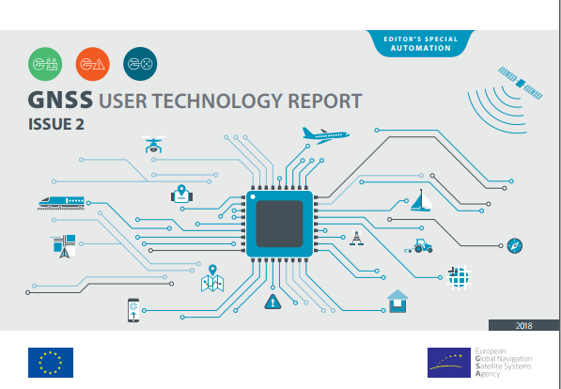

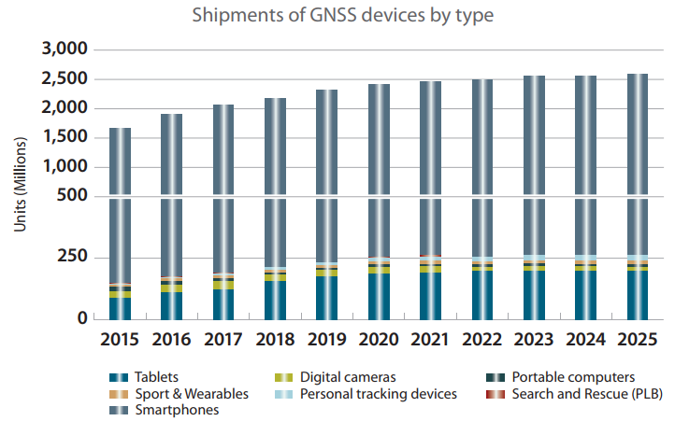
The second issue of the GNSS User Technology Report, a publication on user technology
Available for download at GSA website
2nd edition of GSA`s GNSS User Technology Report (Sept 2018)
General overview of the latest GNSS receiver technology common to all application areas
An in-depth analysis of GNSS user technology as it pertains to three key macrosegments:
  Mass market solutions
  Transport safety and liability-critical solutions
  High precision, timing and asset management solutions
Editor’s special on Automation and increasingly important role of GNSS
5th edition of GSA`s GNSS Market report (May 2017)
GNSS market overview
Macrotrends impacting GNSS across market segments
For each of eight segments:
  market segment updates, opportunities
  and trends
Editor’s special on Drones
Available for download at GSA website

Slide 39











Linking space to user needs
How to get in touch:
www.GSA.europa.eu
EGNOS-portal.eu
GSC-europa.eu
G
UseGalileo.eu

Slide 40
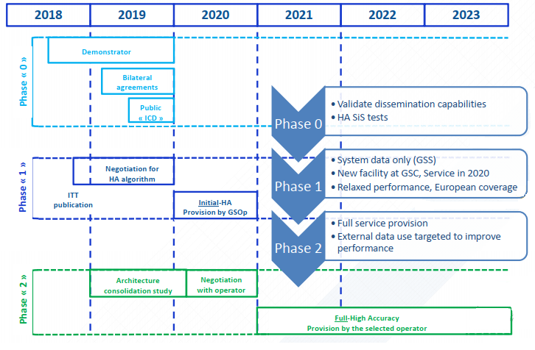
HAS Roadmap

Slide 41
Choice for 2nd and 3rd GNSS frequency
E5/L5, a protected frequency
E6: 3rd Frequency
E6 High quality open signal (modulation, chipping rate)
E5/L5: 2nd Frequency
Shared by all GNSS and SBAS
More widely separated from L1, thus minimising the iono-free linear combination errors
Best frequency for tri-laning
Multiple signals bring greater reliability and accuracy
Notes:
L1 is more widely separated from E5 therefore supports easier to eliminate ionospheric errors: by comparing difference between ionospheric delays on the two frequencies.

Slide 42
Galileo is the European GNSS under civilian control, delivering unique features
Development of new value-added services
Improvement of existing ones
Multi-Constellation
OS-NMA*
SAS**
Multipath Resistant
High Accuracy Service
  Worldwide navigation system “made in EU”
  Only constellation under civilian control
  Fully compatible with other GNSS constellations
  Open service free of charge, delivering multiple frequencies
  Only constellation that provide Signal authentication providing trustability for civilians and global high-accuracy service for free
Galileo differentiators
*Open Service Navigation Message Authentication
**Signal Authentication Service
Galileo + other GNSS

